Slide 1


TNH-200-101 (6)
Plant Power Supply
Clarified Water
Filtered Water
Demi Water
Potable Water
Cooling Tower
Plant Air
Instrument Air
Nitrogen Generator

Slide 2
Power Supply
Coal – Fired Steam Turbine Generator
Capacity
    Boiler - 300 tons/hr steam production
    Turbine - 48 Mega Watts power generation
Emergency Generators
    7 units
    18 Mega Watts each

Slide 3
Clarified Water
River water that descends from the falls are collected in a water intake pond
This river water classified as raw water, WRA is feed to river water clarifier system to produced a clarified water for plant use
The system is designed to removed/reduce the suspended solids present in the river water making it appropriate for process use

Slide 4
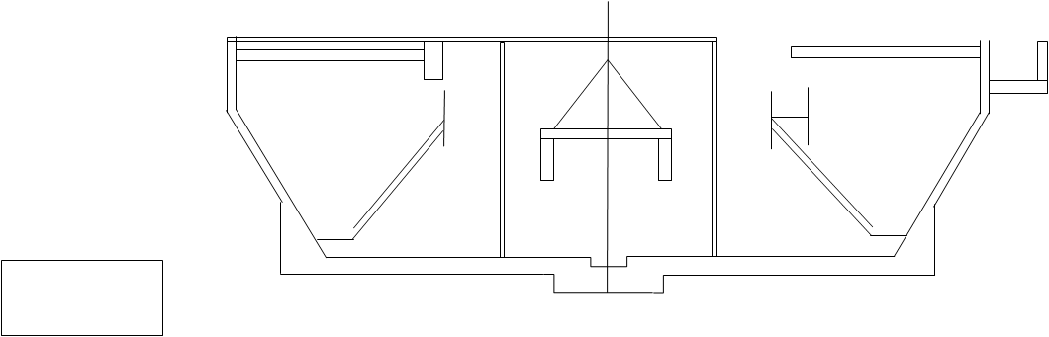

Clarified Water
M
Water Intake
Pond
Chemical Dosing
Unit
River Water Clarifier
System
513PD02A
513PD02B
Plant Use
511PD01
511PU02AB
Ditch
513PU01ABC

Slide 5
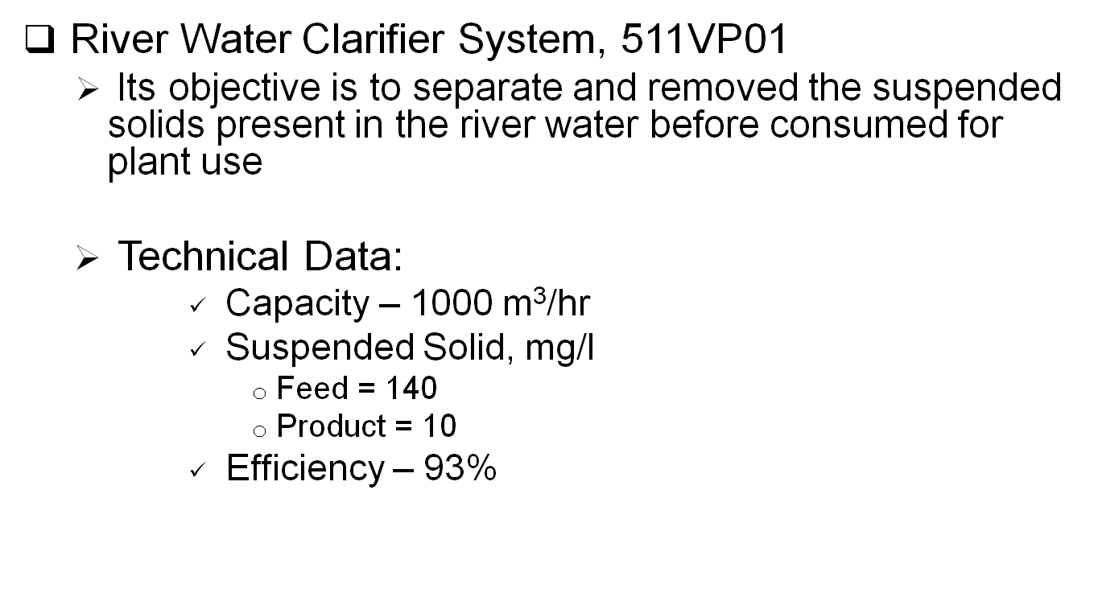
Clarified Water

Slide 6
Filtered Water
Clarified water still contains considerable amount of suspended solids
It is then fed into the Raw Water Filtration Unit, 513VP01 to produced a filtered water.
Filtered water is mostly used for plant’s mechanical seal water system
Also used for backwashing of polishing and pressure filters and makeup water for scrubbers

Slide 7





Filtered Water
Clarified
Water
Air
513BW01AB
Raw Water Filtration Unit
Filtered
Water
513PU06ABC
513TK01
513PU02ABC

Slide 8
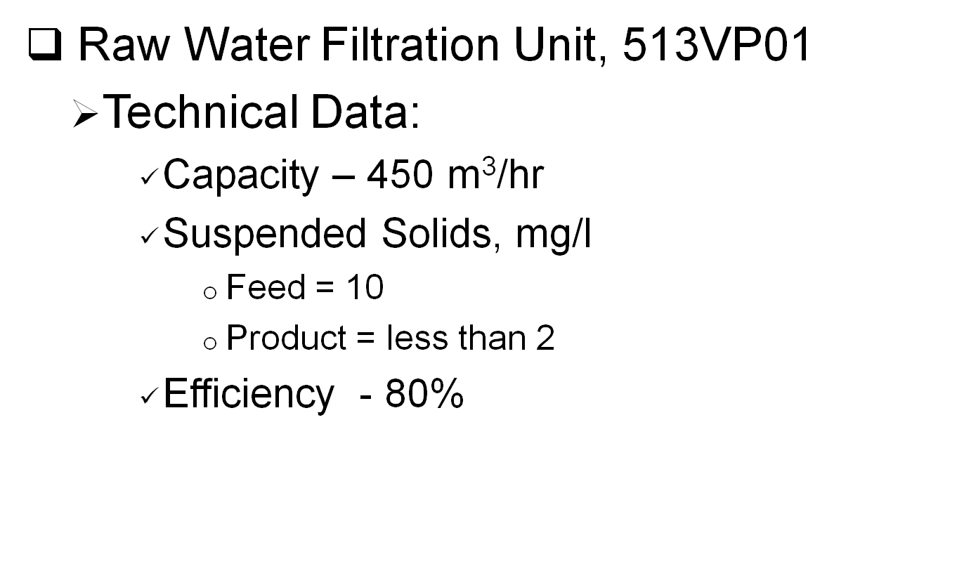
Filtered Water

Slide 9
Potable Water
Filtered water from raw water filtration unit will pass thru a series of filters to produce potable water for plant use.
Potable Water Package, 514VP01 is consists of Pre Filtration Unit, Activated Carbon Filters and a Reverse Osmosis unit.
The package had a 10 m³/hr capacity

Slide 10


Potable Water
514FT02ABCDEFG
514FT01ABC
Activated Carbon Filters
Filtered
Water
Plant Use
514FT03
514FT04
Reverse Osmosis
Unit
514PU04
514TK01
514PU01AB

Slide 11
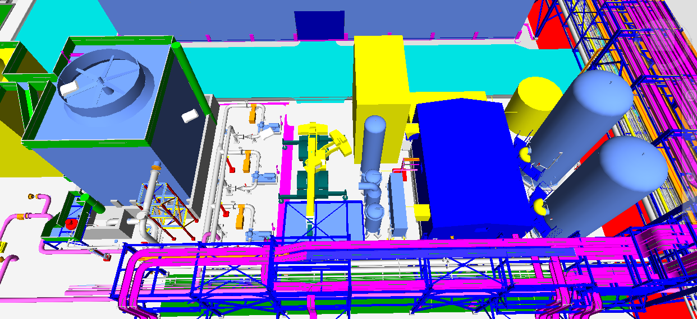
Cooling Tower and Nitrogen Generator

Slide 12
Cooling Tower System
A cooling tower is a heat rejection device which extracts waste heat to the atmosphere through the cooling of a water stream to a lower temperature.
It is mainly used for cooling the warm water coming from the cooling water return of the process area
This induced draft type cooling tower makes the heat exchange between the cooling fluid and the induced air through the tower

Slide 13
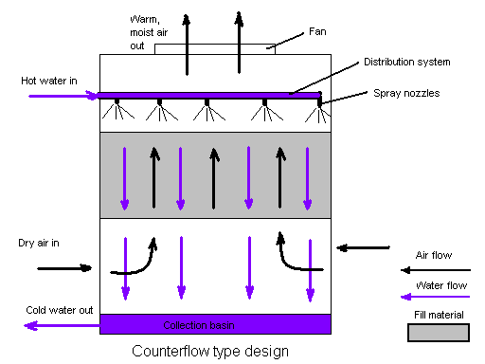
Cooling Tower Process Flow
The air flow is directly opposite to the water
flow. Air flow first enters an open area beneath
the fill media and is then drawn up vertically by fan. The water is sprayed through pressurized nozzles and flows downward through the fill, opposite to the air flow.
The interaction of the air and water flow allow a partial equalization and evaporation of water.
The air saturated with water vapor is discharge from the cooling tower
A collection basin is used to contain the water after its interaction with the air flow

Slide 14
Cooling Tower
Technical Data
  Total Circulating Water Flow: 2, 000 m³/H
  Hot (Inlet) Water Temperature: 42°C
  Cold (Outlet) Water Temperature: 32°C
  Wet Bulb Temperature (inlet): 29°C
  Relative Humidity: 85%
  Drift loss (% of circulating flow): 0.005 or less
  Evaporation loss % (at design): 1.48 or less than 1.5

Slide 15
Air Package: Plant and Instrument
The plant has four available compressors to supply the requirement of plant and instrument air.
Only 3 compressors are required during normal operation and the other one is spare
Each compressor has a capacity of 1,150 Nm³/hr
Compressed air is passed thru a drier to produce instrument air
Plant air pressure is 790 kPag
Instrument air pressure is 690 kPag

Slide 16
Air Package: Plant and Instrument
WCF
WCR
Plant Air
521VE01
Instrument
Air
521VE02
521DR01AB
Instrument Air Dryer
521CP01ABCD

Slide 17
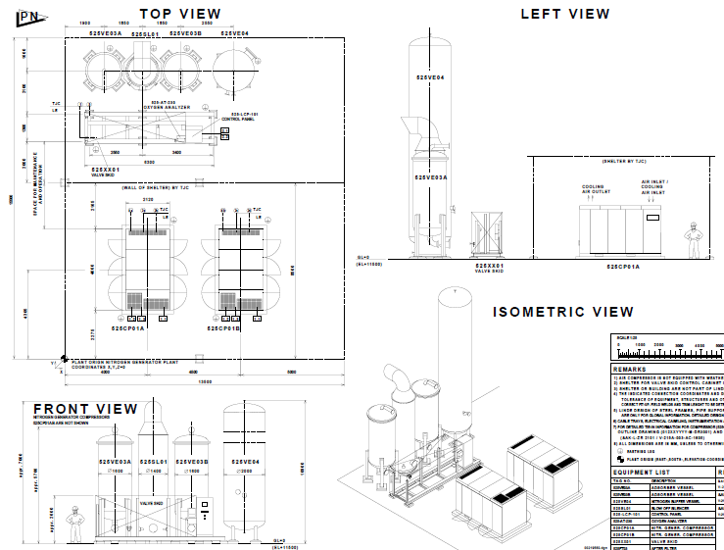
Nitrogen Generator

Slide 18
Nitrogen Generator
The Nitrogen Generator is designed to recover Nitrogen from air.
It uses the PSA process (Pressure Swing Adsorption) to produce two outgoing streams; a continuously product nitrogen gas stream and waste gas stream which is discontinuously blow out to the atmosphere.
The recovery, generation of the nitrogen will be done on the PSA valve skid.
The feed gas to the process is compressed air produced form the nitrogen generator compressors which is also included in the Nitrogen Generator Package

Slide 19
Nitrogen Generator
525NG01 – Nitrogen Generator for MS Plant
      PSA type Nitrogen Generator
      Capacity – 2,350 Nm³/hr
      Product Pressure – 900 kPaG
      Purity - >99% N₂
525NG02 – Nitrogen Generator for H2S Plant
      PSA type Nitrogen Generator
      Capacity – 1,600 Nm³/hr
      Product Pressure – 920 kPaG
      Purity - >99% N₂
      421VP02 – Nitrogen Purifier
        For further removal of Oxygen by palladium catalyst
      421DR01AB – Nitrogen Dryer
        Heat less dryer with Activated Alumina

Slide 20
Nitrogen Generator
Product: Gaseous Nitrogen
Capacity Flow rate: 1600 Nm³/hr
Nitrogen Purity (oxygen content max): <1.0 vol % O₂
Nitrogen supply pressure at B.L Min.: 0.92 MPag
Dew Point: -40ºC to 0.9MPag
Feed Air
  Quality: Normal ambient air, free of water drops/mist and abnormal contents of dust, chemicals, carbon dioxide, hydrocarbons and corrosive elements
  Flow rate approximate: 50 Nm3/hr
Pressure inlet valve skid: 1.0 MPag
Temperature approximate: +16 to +35 ºC

